Slide 1
ST1510 Programming for Data Analytics – CA1 Data Analysis on Job Postings Using Pandas & Matplotlib
Name: Ethan Chuwa Si Xuan
Admin.no: p2508638
Class: Daaa/ft/1b/04
Research question: “How do estimated salaries vary in relation to key job-related factors within the job market?”

Slide 2
Analysis summary
Defining title and research question
Importing libraries
Load datasets
Data exploration using .shape, .head() and .dtypes
Merging, comparing and cleaning of datasets
Keeping useful columns and dropping not useful columns based on research question
Conversion of columns to meaningful data like listed_time
Calculation of median salary if NaN based on min salary and max salary.
Conversion of all currency to USD
Conversion of different pay periods to annual based on work type.
Remove non-representative values of salary
Impute missing data
Category mapping
Plotting of charts and analysis

Slide 3
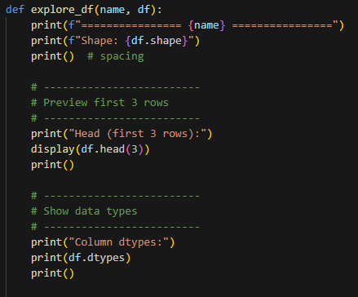
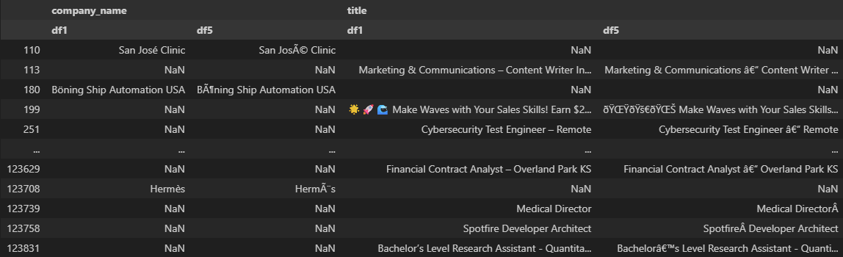
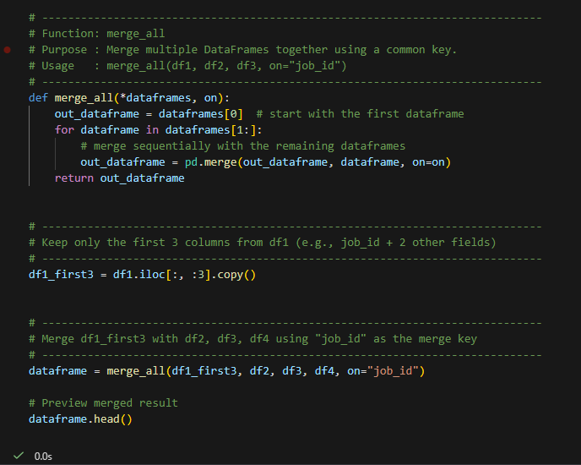
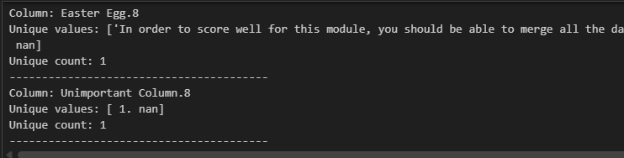
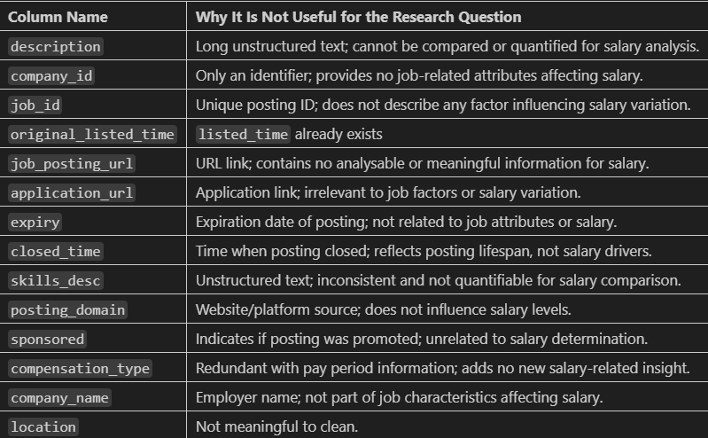
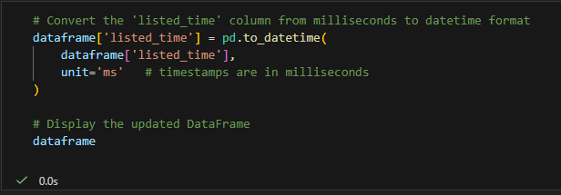
Data analysis using pandas
Examination of all dfs using .shape, .head() and .dtypes to visualise all the datasets.
Comparison of df1 and df5 as they are similar. df5 is found to have corrupted data hence df1 is used instead.
Making sure that “junk” columns in df1 are actually not meaningful and can be ignored safely.
Merging of df1 to df4 on job_id.
All columns deemed unnecessary for my research question are dropped.
Used .to_datetime() to convert listed_time to a readable format.

Slide 4
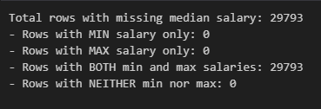

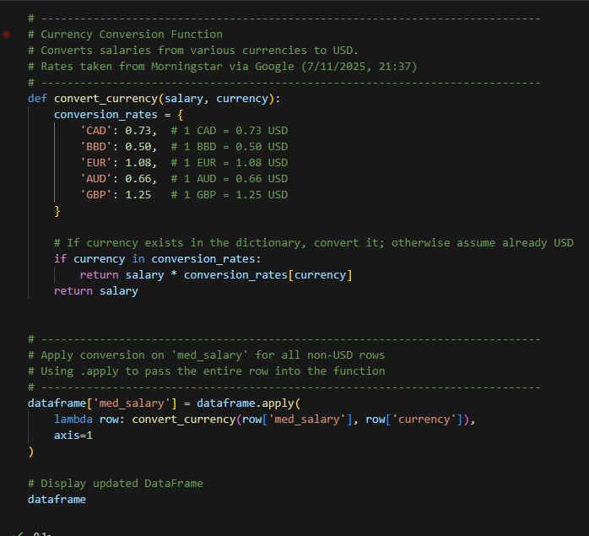
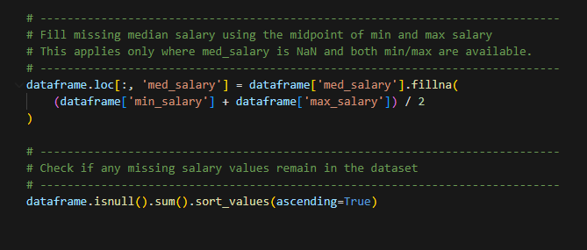
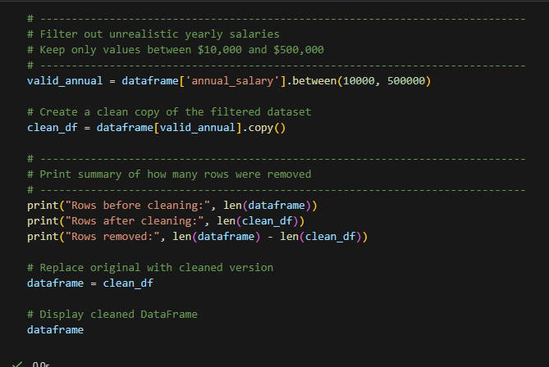
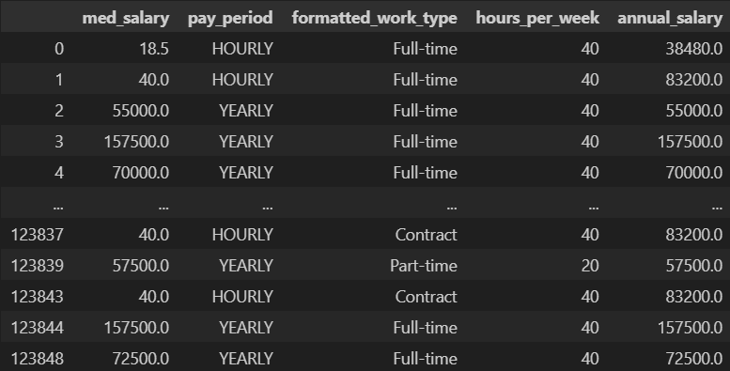
Data analysis using pandas
NaN values inside currency is dropped as there is no meaningful way to calculate salary for comparison without currency.
Found out that median salary can always be calculated using min and max salary as both min and max will exist when med does not while med will exist if the other two do not.
Filled in missing med using min and max salary.
Conversion of all salary based on currency to USD for comparison later on.
Conversion of all salary to annual based on pay period and work type for comparison later on. Conversion rates are based on US Standard work schedule.
Filter for unrepresentative and unrealistic salary data so it wont distort future analysis.

Slide 5
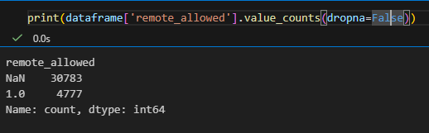
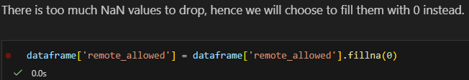
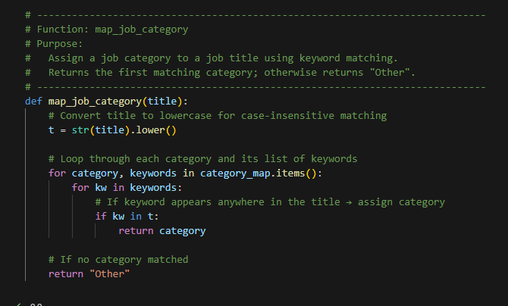
Data analysis using pandas
13. Using .value_counts(), it is revealed that remote allowed column has too many NaN values for us to drop.
14. Hence they are filled in with ‘0’ instead.
15. Same case for experience level, we will fill NaN values with ‘Unknown’ instead of dropping as data can still be useful later on.
16. There are too many jobs hence we map each job to a category so it can meaningfully analysed later on.

Slide 6
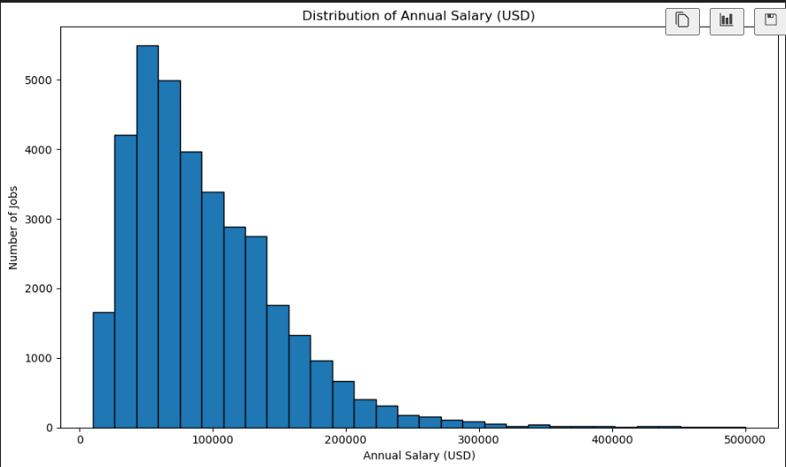
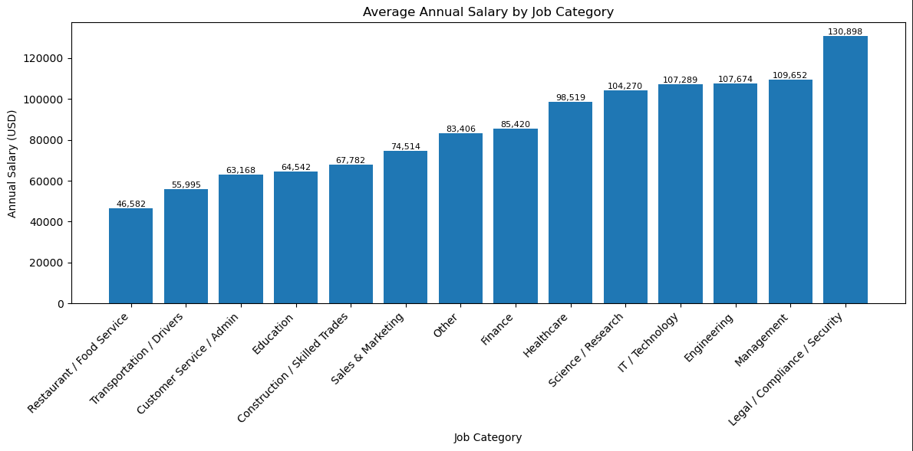
Data analysis using matplotlib
1. Distribution of Annual Salary (Histogram)
Description: This chart shows the overall spread of annual salaries in the job market. Most roles fall within the $40k–$120k range, with fewer high-paying positions above $150k. The distribution is right-skewed, indicating that mid-range salaries dominate, while very high salaries are rare.
2. Average Annual Salary by Job Category (Bar Chart)
Description: This visual compares salary levels across job categories. Higher-paying sectors include Legal/Compliance/Security, Management, IT/Technology, Engineering, and Healthcare, while lower-paying categories include Food Service, Customer Service, and Transportation. This shows that industry type strongly influences earnings.

Slide 7
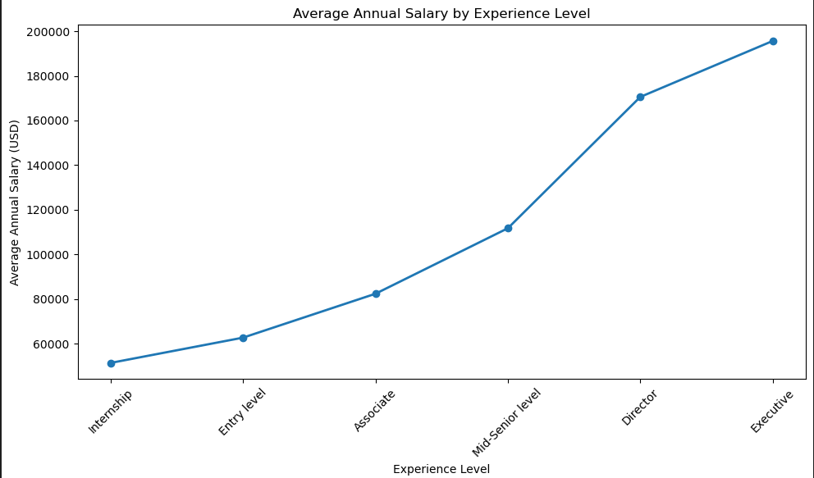
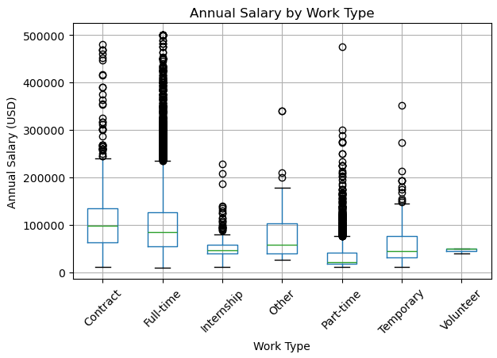
Data analysis using matplotlib
3. Average Annual Salary by Experience Level (Line Chart)
Description: The line chart displays a clear upward salary progression from Internship → Executive roles. Each step in seniority results in higher pay, with executive roles earning nearly four times more than interns. Experience level is one of the most important predictors of salary.
4. Annual Salary by Work Type (Box Plot)
Description: This boxplot compares salary distributions across work types. Contract and Full-time roles show the widest range and highest salaries, including many high-value outliers. Part-time roles have lower median salaries, while internships and volunteer roles offer minimal compensation. This indicates that work type significantly impacts pay.

Slide 8
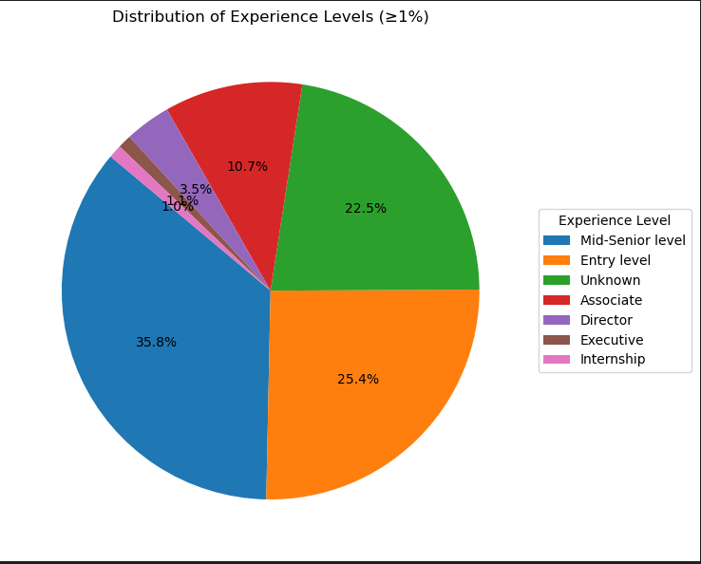
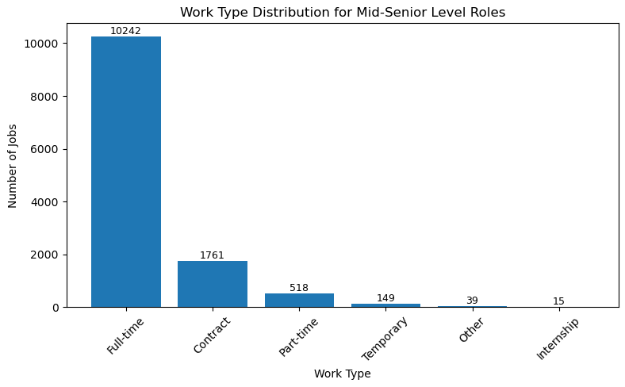
Data analysis using matplotlib
5. Distribution of Experience Levels (Pie Chart ≥1%)
Description: This pie chart shows the proportion of experience levels in the dataset. Most roles fall under Mid-Senior level, followed by Entry level and Associate. Higher positions such as Director and Executive appear far less frequently, explaining why overall salary levels remain centred around mid-range values.
6. Work Type Distribution for Mid-Senior Level Roles (Bar Chart)
Description: This chart highlights work types within Mid-Senior level jobs. The majority of these positions are full-time, with significantly fewer contract, part-time, or temporary roles. This heavy concentration of full-time positions explains why the full-time salary boxplot contains many upper salary outliers.

Slide 9
Key insights
Overall Salary Patterns
Most salaries fall between $40k–$120k, with fewer high-paying roles above $150k.
Salary distribution is right-skewed, meaning mid-range roles dominate the market.
Job Category & Salary
Highest-paying sectors: Legal/Compliance/Security, Management, IT/Technology, Engineering, Healthcare.
Lowest-paying sectors: Food Service, Customer Service/Admin, Transportation.
Industry type clearly influences expected salary.
Experience Level & Salary
Strong upward progression from Internship → Executive.
Executive roles earn up to 4× more than interns.
Experience level is the strongest predictor of salary.
Work Type & Salary
Full-time roles show the highest median salaries and widest range.
Contract/part-time roles pay less; internships/volunteer roles pay least.
Work type significantly impacts earning potential.
Workforce Composition
Dataset is dominated by Mid-Senior and Entry-level roles.
Fewer Director/Executive roles explain why overall salaries centre around the mid-range.
Mid-Senior Work Type Breakdown
Most Mid-Senior jobs are full-time, explaining many high full-time salary outliers.
Contract/part-time roles exist but are minority.
CONCLUSION: Salaries vary significantly based on experience level, job category, and work type. The combination of seniority, industry, and employment arrangement shapes earning potential in the job market.

